Slide 1

Media Streaming with IBM Cloud Video Streaming
Cloud Application Development

Slide 2
Objective:
The objective of the project on Media Streaming with IBM Cloud Video Streaming is to create a comprehensive and effective media streaming solution. This involves selecting IBM Cloud Video Streaming as the platform and leveraging its features for optimal performance.
The project includes the preparation of various media content, such as videos and live events, along with the configuration of encoding and transcoding settings to ensure content compatibility and quality across a range of devices and network conditions.
Live streaming and on-demand video delivery will be established, offering users both real-time and pre-recorded content access. Customization features, including branding and interactive elements, will enhance the user experience.
Security measures will be implemented to safeguard content from unauthorized access and piracy. Additionally, analytics and monitoring tools will be integrated to gather insights into viewer behavior and stream performance. Scalability and quality of service are paramount, ensuring the solution can handle increased demand while maintaining a high-quality streaming experience.
Thorough testing, optimization, and documentation are essential components of the project, along with a cost analysis to ensure efficient resource utilization. Deployment, user training, and project evaluation will complete the implementation phase. Lastly, the project will culminate with recommendations for future enhancements and adjustments to align with evolving requirements and technologies.

Slide 3
Design Thinking Process:
The design thinking process is a human-centered, iterative approach to problem-solving and innovation that places a strong emphasis on empathy and understanding the needs of end-users.
It typically consists of five key stages: empathize, define, ideate, prototype, and test. In the "empathize" stage, designers seek to gain a deep understanding of the users' perspectives and challenges by conducting research, interviews, and observations
The "define" stage involves synthesizing the collected insights into a clear and actionable problem statement. The "ideate" stage encourages brainstorming and generating creative solutions to address the defined problem.
Subsequently, in the "prototype" stage, rough representations of these ideas are created to visualize and communicate potential solutions. Finally, the "test" stage involves putting these prototypes in the hands of users, gathering feedback, and iterating on the designs based on user input.
Design thinking promotes a flexible and collaborative approach, allowing for the development of innovative solutions that better align with the users' needs and preferences. It has found applications in various fields, from product design to service delivery and organizational problem-solving.

Slide 4
Development Phases:
The development phases refer to the stages or steps involved in the process of creating a product, system, or solution. These phases are typically organized in a sequential or iterative fashion and are followed to ensure a structured and efficient development process. While the specific phases can vary depending on the type of project or methodology used, here are the general phases often associated with software and product development:
Planning and Requirements Gathering:
In this initial phase, the project's objectives are defined, and the requirements are gathered. This involves understanding the problem to be solved, setting project goals, and collecting input from stakeholders to establish a clear scope.
Design:
The design phase involves creating detailed plans and specifications for the product or system. This includes architectural design, user interface design, and technical design. Design decisions are made to address how the project will meet its requirements.

Slide 5
3. Development:
This is the phase where the actual development work takes place. Developers write code, build the software, or manufacture the product based on the design specifications. This phase may include multiple iterations as code is tested and refined.
4. Testing and Quality Assurance:
In this phase, the developed product is rigorously tested to identify and fix defects, ensure functionality, and verify that it meets the specified requirements. Testing may include unit testing, integration testing, and user acceptance testing.
5. Deployment:
Once the product has passed testing and quality assurance, it is deployed for actual use. This phase involves the installation, configuration, and rollout of the product to end-users or the intended environment.
6. Maintenance and Support:
After deployment, the product requires ongoing maintenance, updates, and support. This phase involves monitoring the product's performance, addressing issues, and releasing updates and patches as needed.
7. Documentation and Training:
Throughout the development process, documentation is created to provide guidance for users, administrators, and developers.

Slide 6
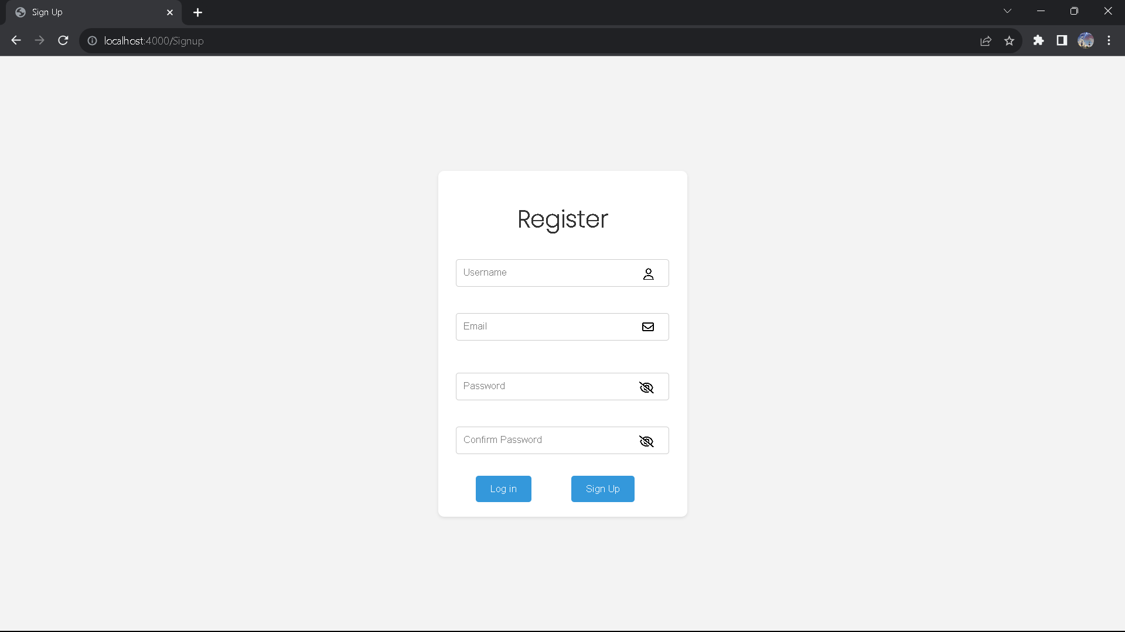
Platform's Features:
Registration Process:
The registration process is the initial step in user engagement within digital platforms. It facilitates the creation of user accounts by collecting vital information from individuals.
Users typically fill out a registration form, providing their personal details, including their name, email address, username, and a secure password.
Data validation measures are put in place to ensure that the information provided is accurate and follows predefined standards. Optionally, email verification may be incorporated to confirm the user's email address and establish their identity.
This process is not only the key to personalizing the user experience but also serves as a foundation for security, privacy, and access control, making it a crucial element in any digital platform.

Slide 7
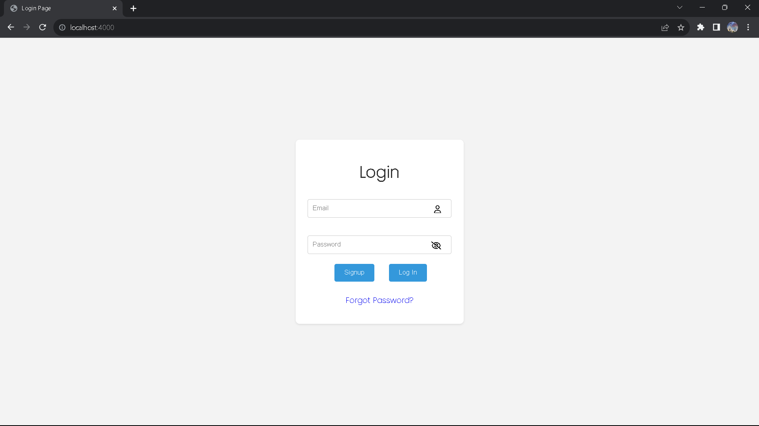
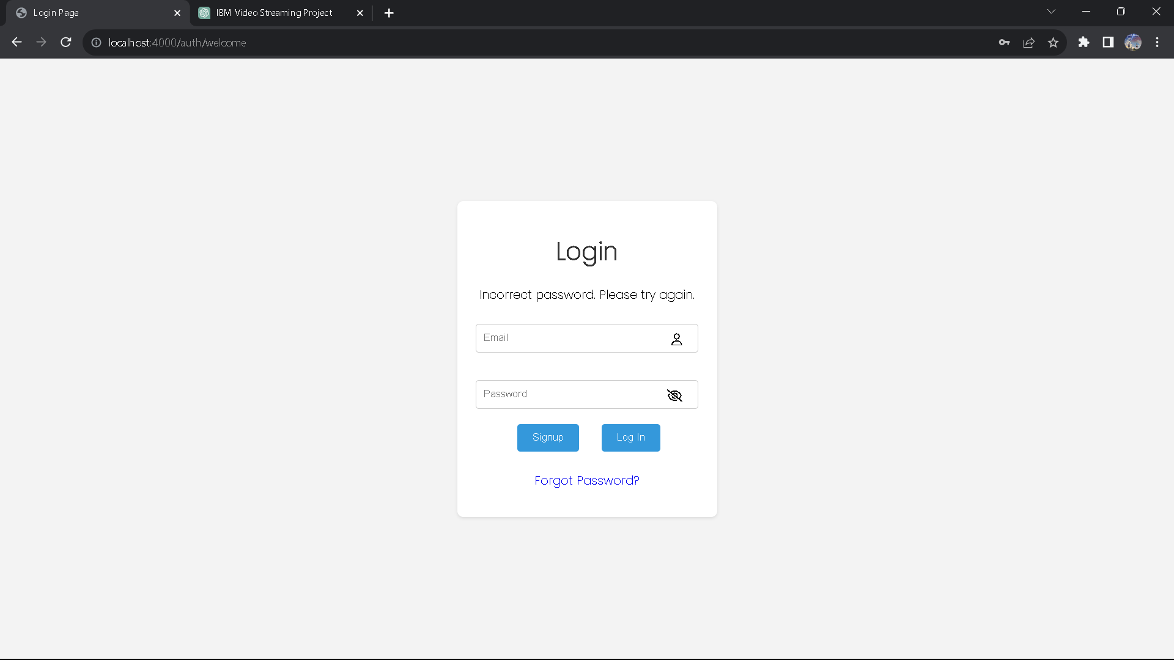
Login Process:
The login process is the gateway for registered users to access their accounts securely. It involves entering their username or email address, along with the associated password.
Security is paramount in this process, with mechanisms such as Two-Factor Authentication (2FA) available for enhanced protection.
User authentication ensures the right individuals gain access to their accounts, guarding against unauthorized entry.
Furthermore, features like account recovery, session management, and profile updates contribute to a comprehensive and user-centric login experience, making it an essential component in user interaction and platform security.
All the information about the user are being fetched from the MySQL database.

Slide 8
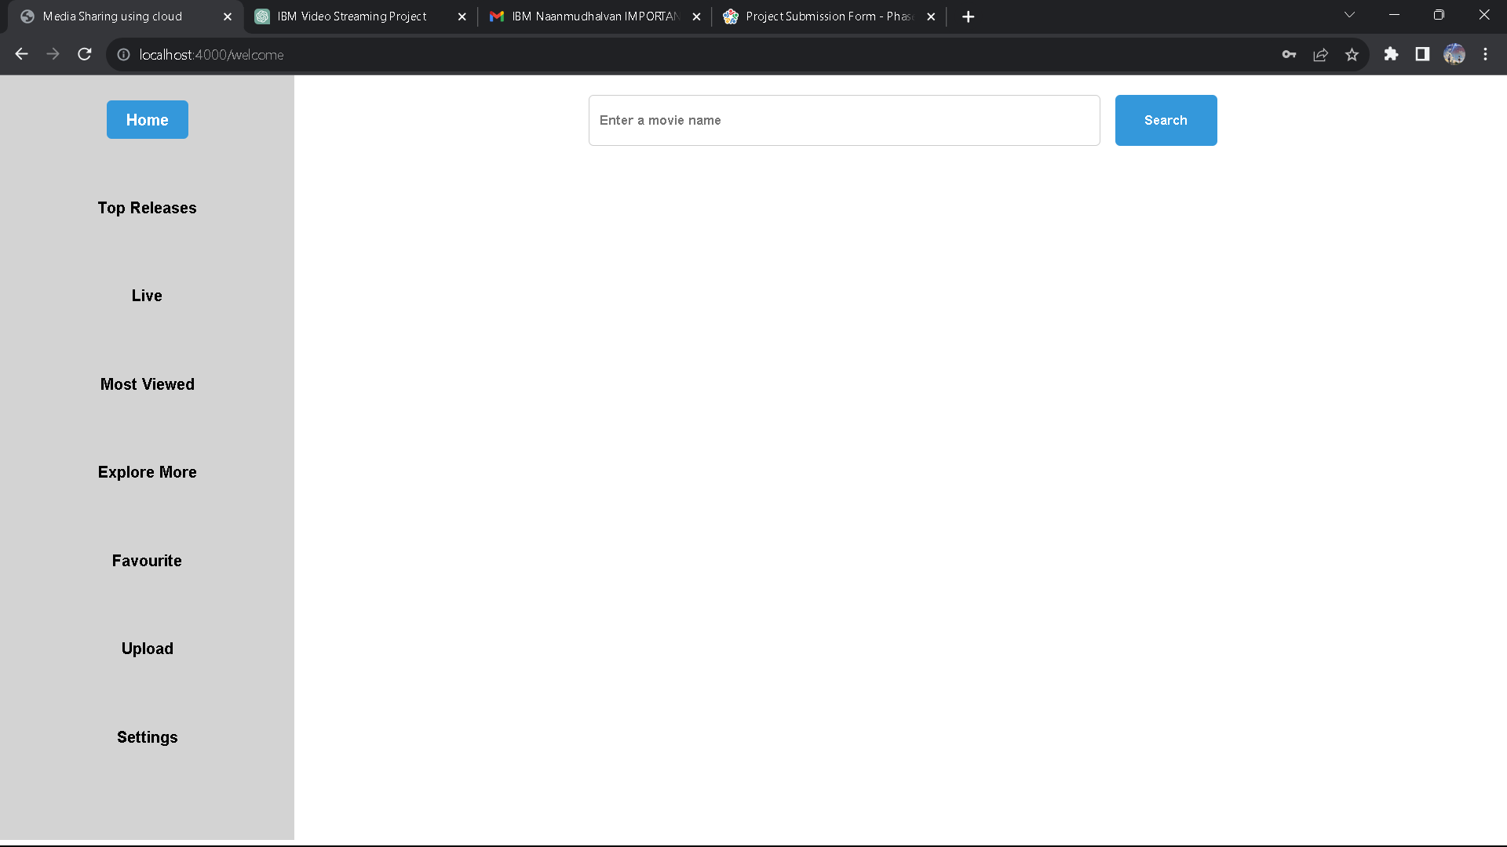
Top Releases:
Regularly showcasing the top releases in the application provides users with a quick and engaging overview of the latest enhancements and features. This not only piques their interest but also encourages them to explore and utilize the application more effectively.
Most Viewed:
Displaying a "Most Viewed" section within the application allows users to easily discover and engage with the content that is currently trending or of high interest to the user community. It serves as a valuable indicator of what's popular, helping users make informed choices about what to explore next, ultimately enhancing their overall user experience.
Upload:
The upload feature exclusively supports video formats, allowing users to contribute and share video content. This specialized functionality ensures that the application maintains a consistent focus on video-based media, making it particularly suitable for platforms dedicated to video sharing, streaming, or other video-centric experiences. Users can effortlessly upload and distribute their video content, creating a dedicated space for video enthusiasts and creators.

Slide 9
Seamless And Immersive Movie-watching Experience:
High-Quality Streaming:
he platform offers high-definition and even 4K streaming capabilities to ensure that users can enjoy movies in the best possible quality. Adaptive streaming adjusts the video quality based on the user's internet connection, providing a buffer-free experience.
Recommendation Engine:
A sophisticated recommendation engine suggests movies based on a user's viewing history and preferences, enhancing content discovery. This personalization ensures that users discover movies tailored to their tastes.
Seamless Playback:
The platform minimizes buffering and loading times by optimizing video delivery. Users experience uninterrupted playback, enhancing the immersion in the movie-watching experience.

Slide 10
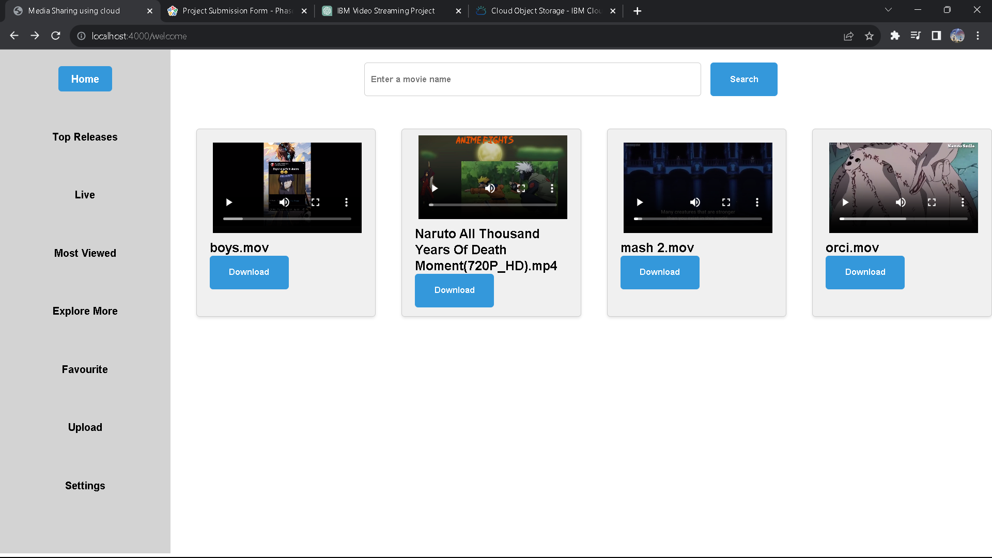

Cross-Device Compatibility:
The application is available on various devices, from smartphones and tablets to smart TVs and web browsers. Users can seamlessly switch between devices and pick up where they left off in their movie, enhancing flexibility.
Offline Viewing:
Users can download movies for offline viewing, making it convenient to watch content while on the go, without needing a constant internet connection.

Slide 11
User Interface Design:
User interface design, often referred to as UI design, is a critical discipline in the creation of user-friendly and visually appealing digital products.
It encompasses the art and science of crafting the visual elements and interactive components that users encounter when they interact with a website, mobile app, software, or any other digital platform.
The primary goal of UI design is to ensure that the user's interaction with the product is intuitive, efficient, and aesthetically pleasing. This involves careful consideration of layout, typography, color schemes, and the placement of buttons, icons, and navigation elements.
. UI designers work to create a cohesive and consistent look and feel that aligns with the brand identity while also optimizing the user's experience.
They need to understand user behavior and psychology to design interfaces that are not only attractive but also functional, accommodating various devices and screen sizes.
A well-executed UI design has the power to enhance user engagement, reduce friction in navigation, and ultimately contribute to the success of the digital product. It's an ongoing process that adapts to user feedback and technological advancements to keep the user interface relevant and effective.

Slide 12
Video Upload Process:
The video upload process using IBM Cloud Object Storage typically involves several steps to store video content securely in the cloud. IBM Cloud Object Storage is a scalable and highly available storage service that can be used for a wide range of data, including video files. Here's an overview of the process
IBM Cloud Account Setup:
Before you can use IBM Cloud Object Storage, you need to sign up for an IBM Cloud account if you haven't already. You'll also need to create a new storage bucket, which is a logical container for storing your video files.
Authentication and Access Control:
You'll configure access control and authentication settings to ensure that only authorized users or applications can upload and access the videos stored in the bucket. IBM Cloud typically provides various security options, including API keys and IAM (Identity and Access Management) policies.

Slide 13
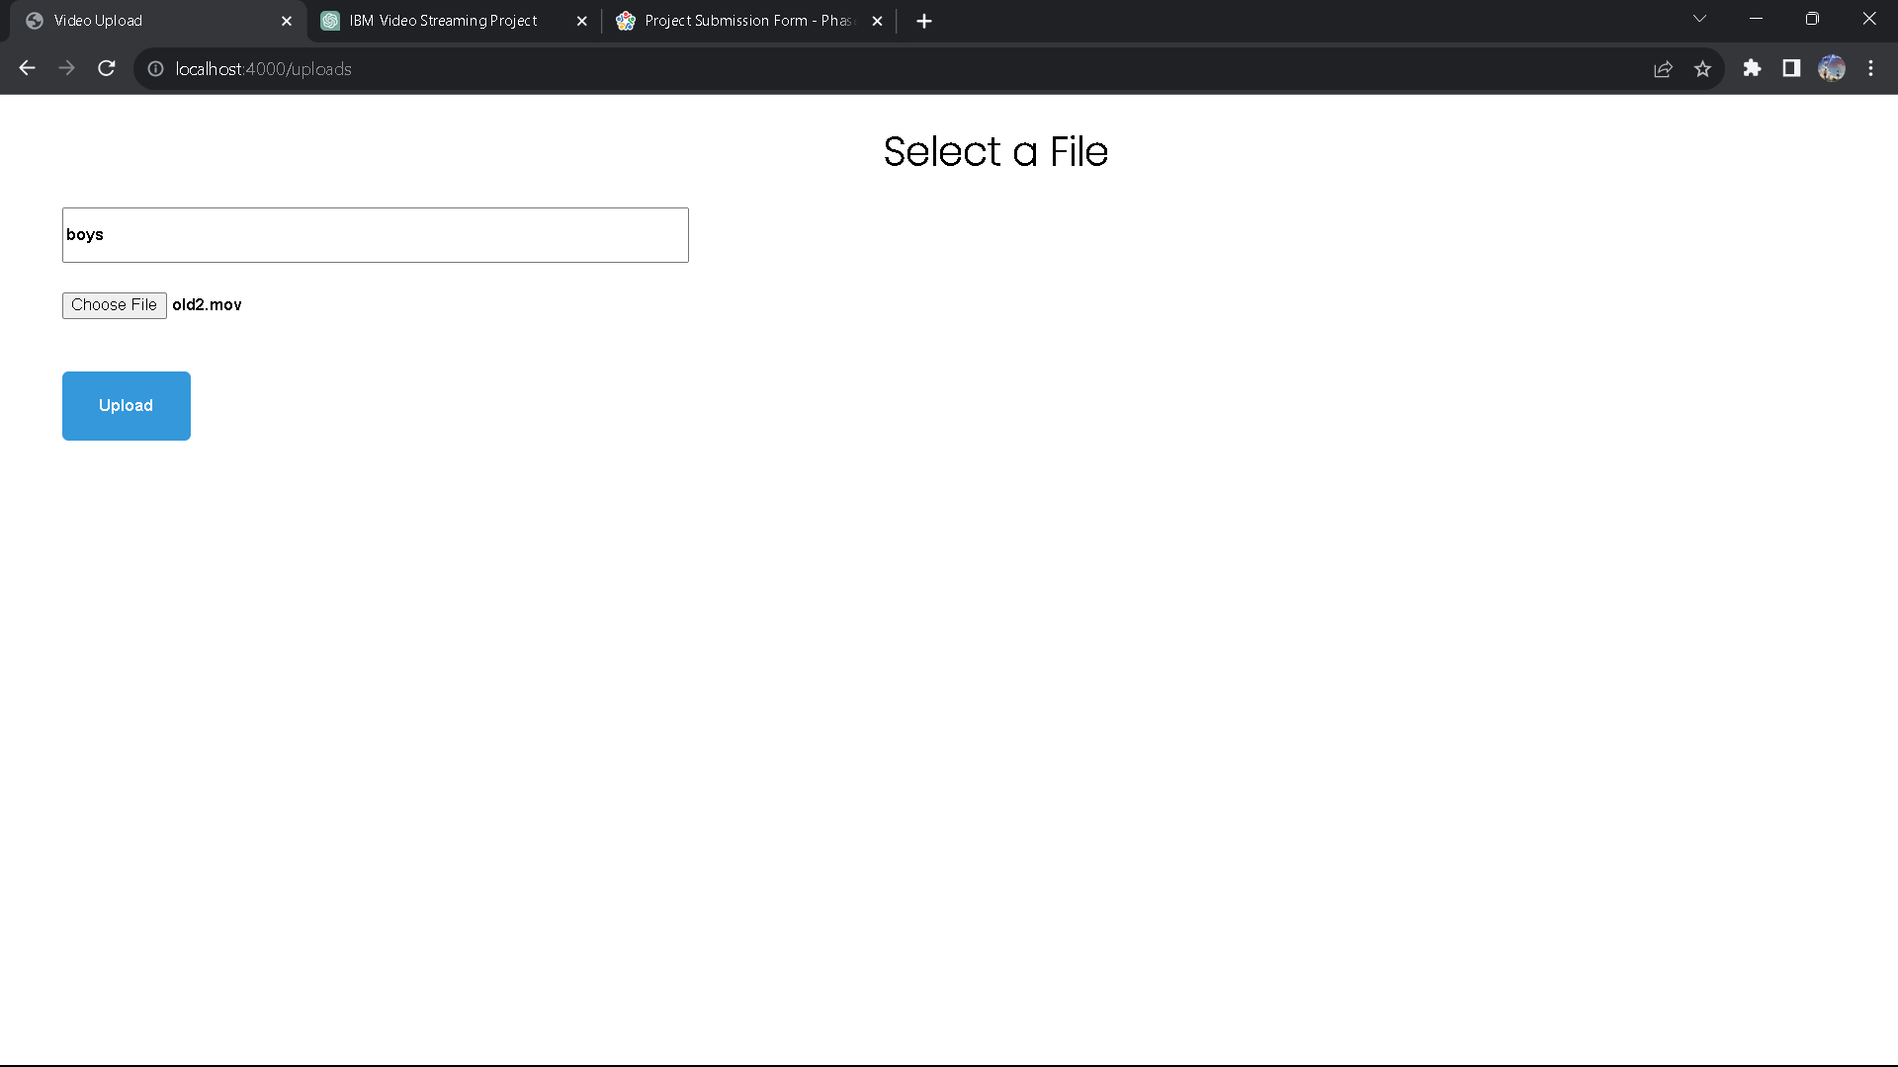
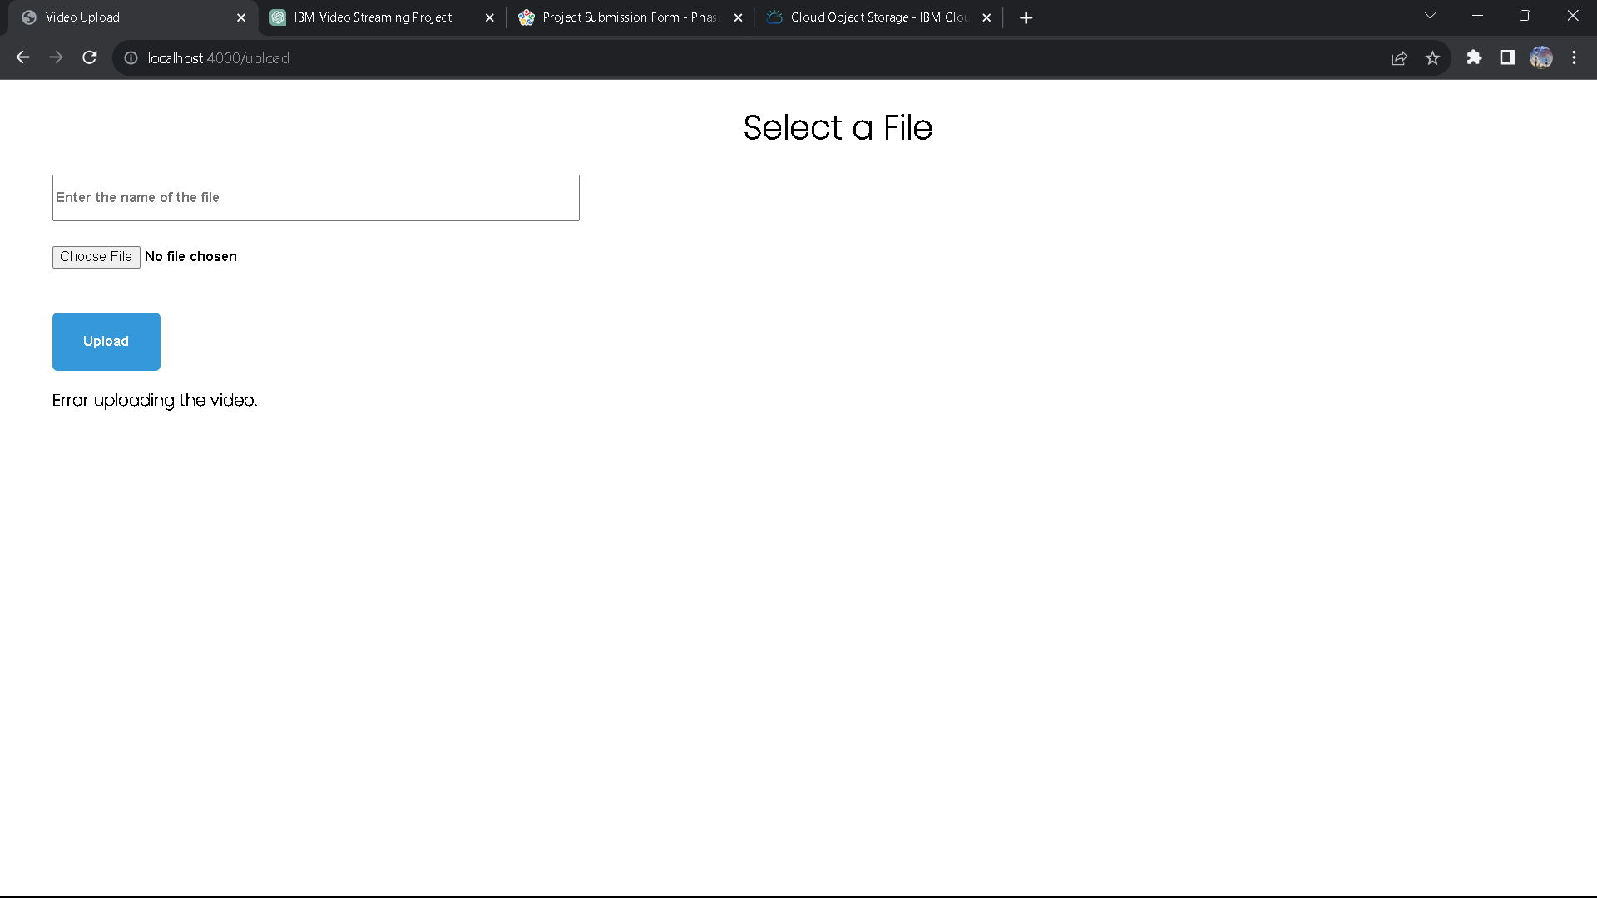
Uploading Videos:
Using APIs:
You can use IBM Cloud Object Storage APIs, such as AWS S3-compatible APIs, to programmatically upload videos. These APIs allow you to integrate your application with the storage service.
Using a Web Interface:
IBM Cloud Object Storage typically offers a web-based dashboard that allows you to manually upload video files using a user-friendly interface.

Slide 14
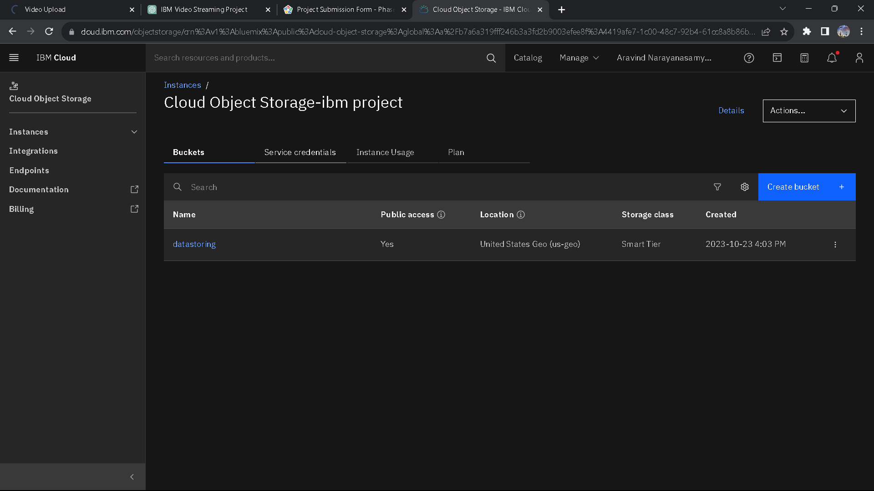
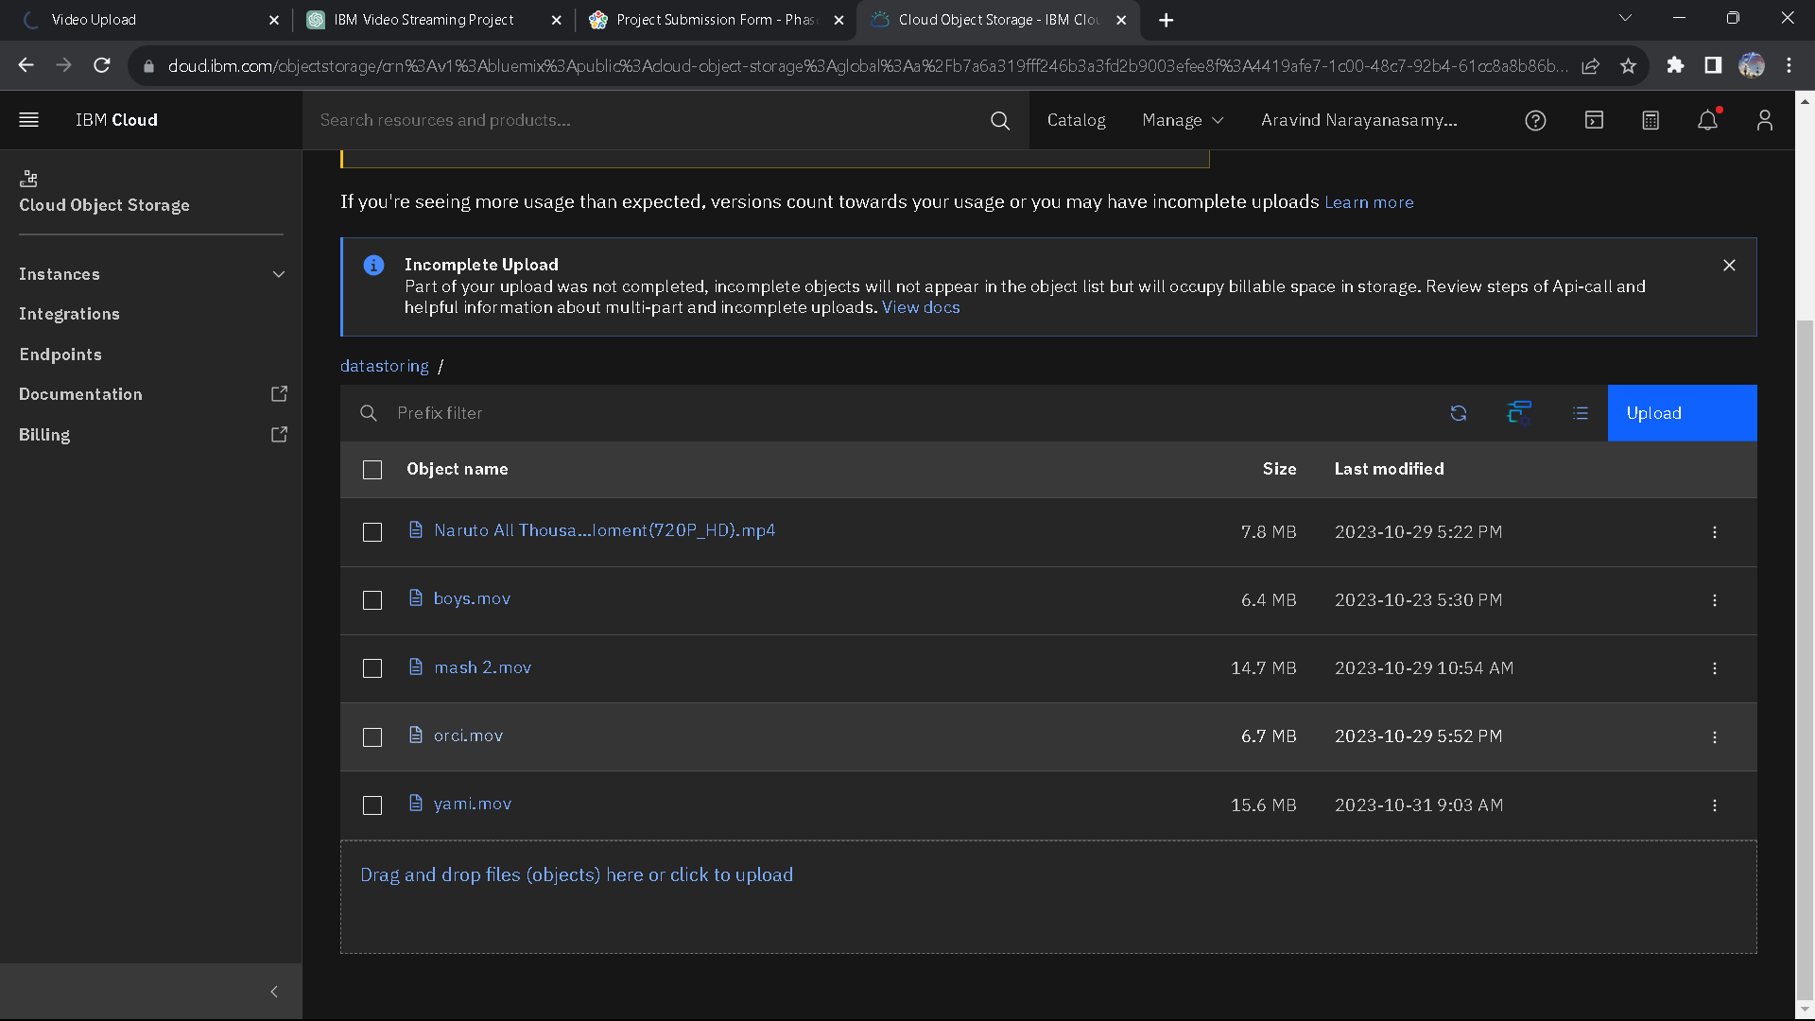
The space which is used to store all the media (or) video as objects in the bucket .A bucket is a object storage service provided by the IBM Cloud.
IBM Cloud Object Storage provides a highly scalable and cost-effective solution for storing vast amounts of unstructured data, such as documents, images, videos, and backups. It offers a reliable and durable repository that can easily expand to accommodate growing data needs, making it an ideal choice for businesses and applications with evolving storage requirements.
Bucket Storage
Objects in the Bucket Storage

Slide 15
Streaming Integration:
Streaming integration refers to the seamless incorporation of streaming technology into digital platforms, applications, or services. It enables the real-time delivery of audio, video, or other data to end-users, enhancing the interactivity and engagement of the platform.
Streaming integration is particularly significant in today's digital landscape, where live events, video content, and interactive experiences have become increasingly popular. Whether it's live video broadcasts, on-demand content, or real-time data feeds, streaming integration empowers businesses and creators to connect with their audience in a dynamic and immediate manner.
This technology has applications in various domains, including entertainment, education, e-commerce, and data analytics.
By effectively implementing streaming integration, organizations can provide users with a richer, more immersive experience, fostering greater audience participation and satisfaction.
Furthermore, as streaming technology continues to advance, it opens up new possibilities for real-time engagement, making it a crucial component for staying competitive in the digital age.

